Slide 1

Predicting Meat Consumption Levels and Investigating the Reduction of Meat Consumption in the United States through Financial Incentives
Final Presentation
Carlos Figueroa, Carla Garcia Medina, Hannah Won
The Karl-Won Project

Slide 2
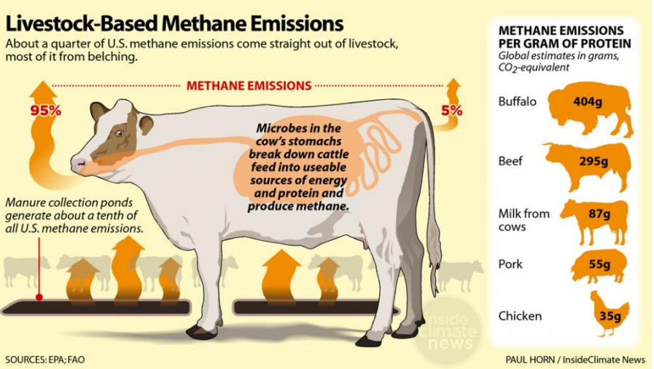
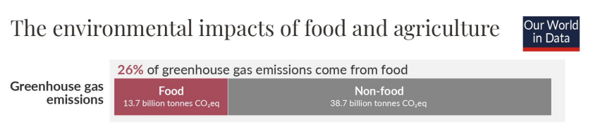
Background
P A R T 0 1
Meat reduction is important in terms of GHE
Short term solutions: taxing and subsidizing
Two distinct goals:
Develop predictor of beef and veal consumption levels given agricultural commodity data given tax regime
Feature analysis to investigate which commodities should be subsidized

Slide 3
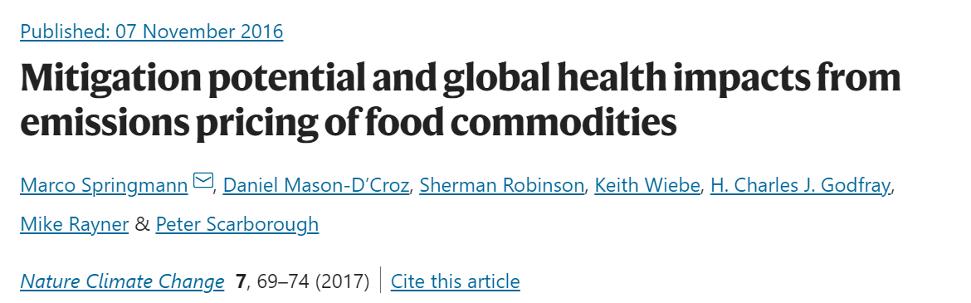
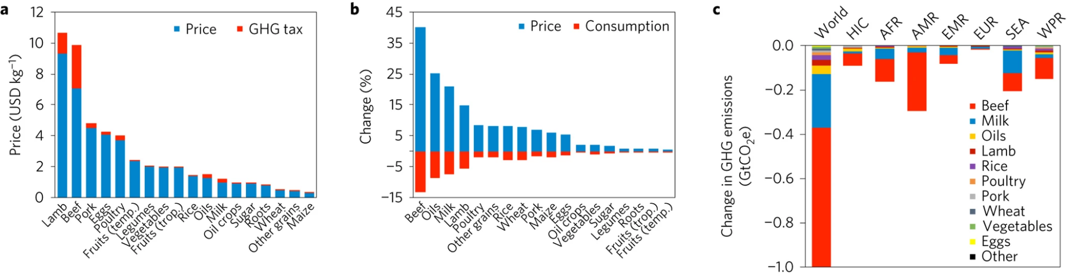
Background
P A R T 0 1
Most used model: The International Model for Policy Analysis of Agricultural Commodities and Trade (IMPACT)
Problems:
Hard to use for the public
Constraint by multiple equilibrium of markets and not predictions based on different products
Not adaptable for changing global conditions
A. Prices and GHG taxes (in US dollars per kg) by food commodity.
B. Percentage changes in prices and consumption by food commodity.
C. Change in GHG emissions (in GtCO2e) by food commodity and region.

Slide 4
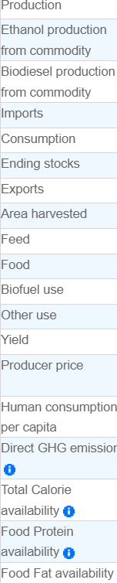
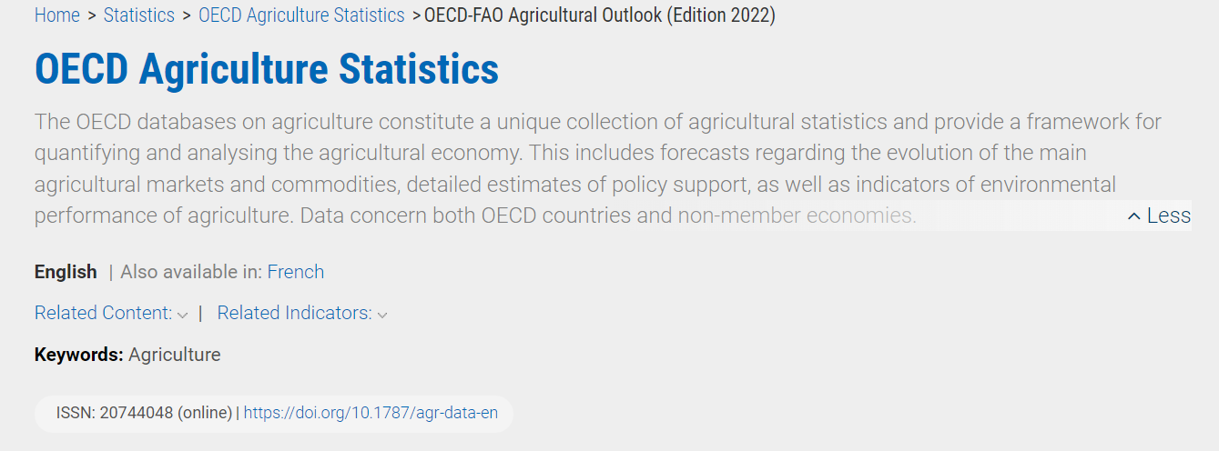
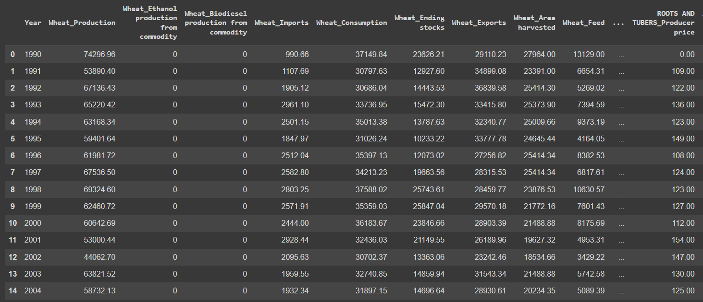
Methods: Data Cleaning
P A R T 0 2
Data description:
34 food products (beef, fish, sugar, maize, etc.)
19 different variables per product
1990 to 2031 (Including OECD predictions)
Cleaning procedure:
Concatenating variables with products
Indexing through the years

Slide 5

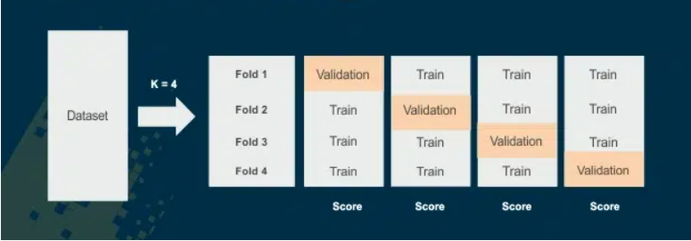
Methods: Prediction
P A R T 0 2

Slide 6
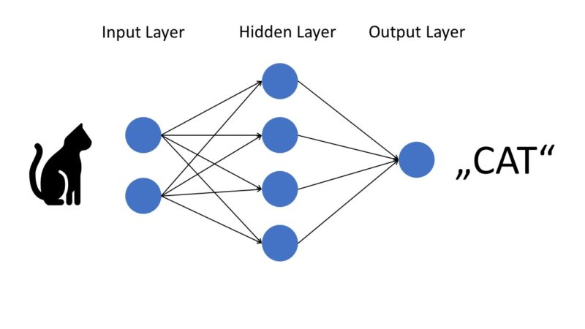

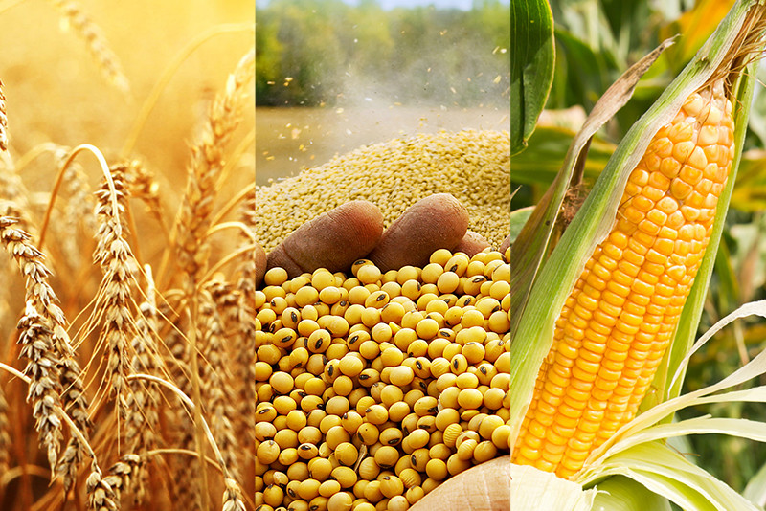
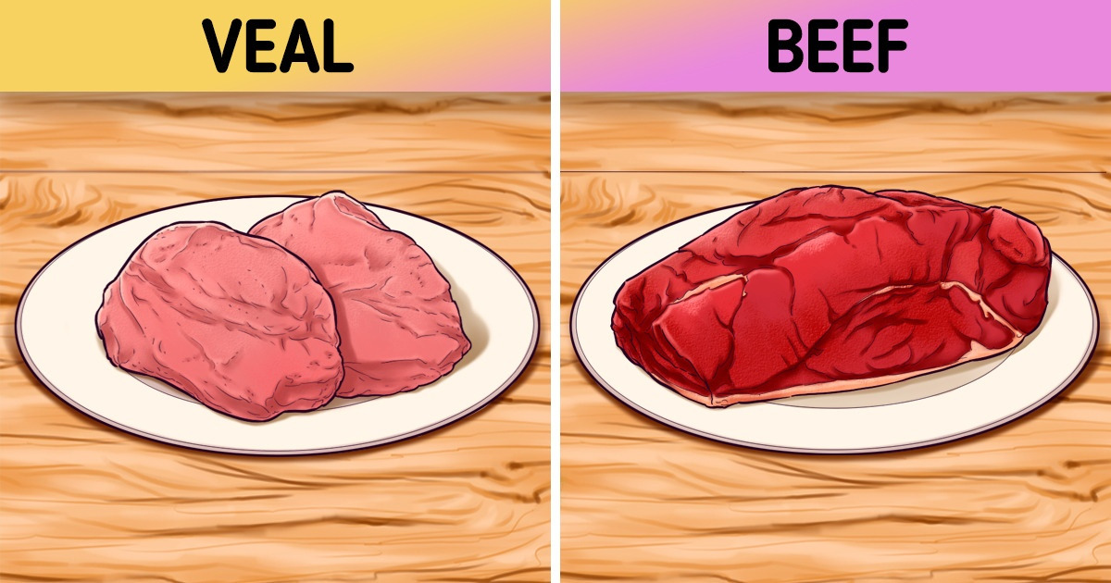
Methods: Prediction
P A R T 0 2

Slide 7
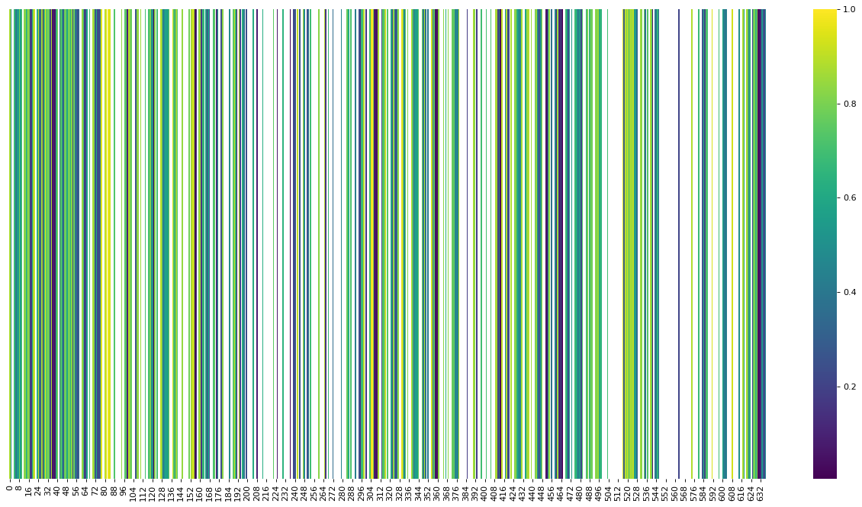
Methods: Feature Analysis
P A R T 0 2
Pearson correlation
Feature importance coefficients of unsupervised models
Dimensionality reduction pipeline (SVD and UMAP with Random Forests)
Evaluation:
Cross-validation since dataset was sparse
Accuracy for classification
MSE for regression
Visually

Slide 8
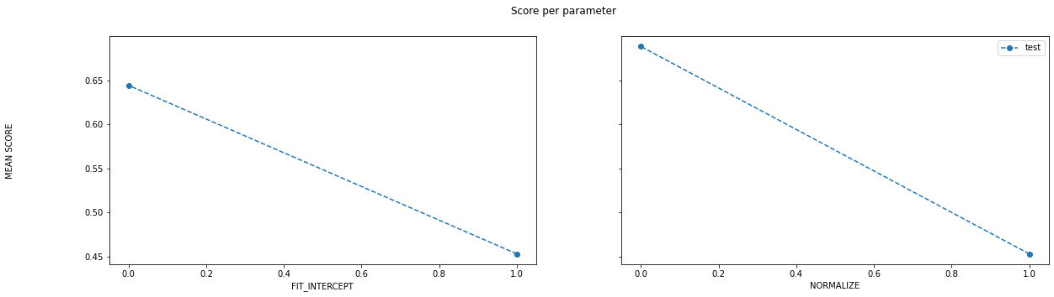
Results: Linear Regression
P A R T 0 3
RMSE
For RMSE, the lower, the better

Slide 9
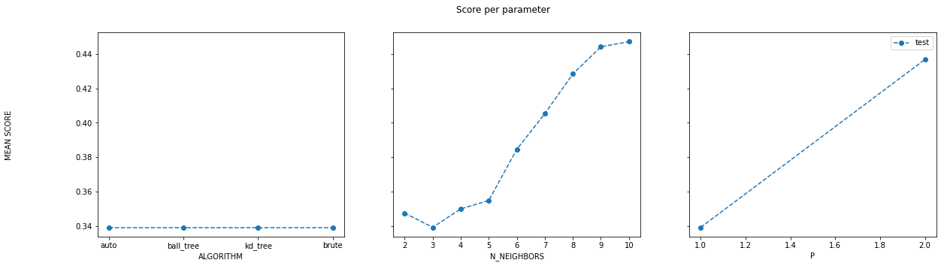
Results: KNeighborsRegressor
P A R T 0 3
RMSE
For RMSE, the lower, the better

Slide 10
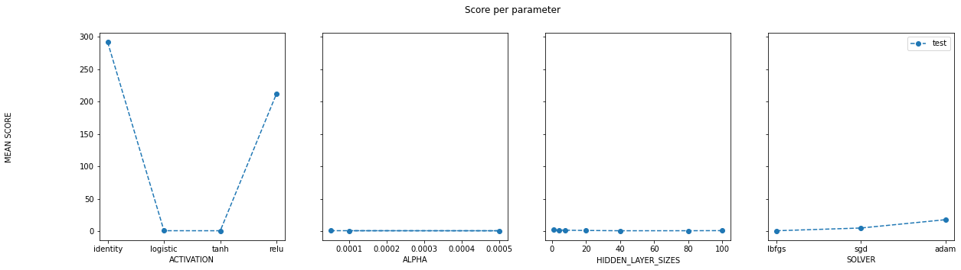
Results: MLPRegressor
P A R T 0 3
RMSE
For RMSE, the lower, the better

Slide 11
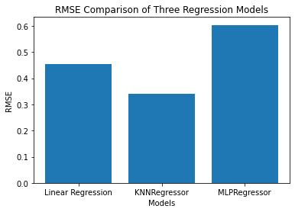
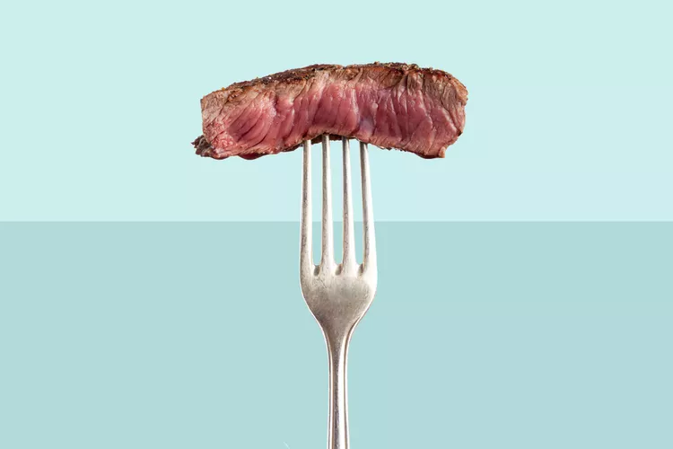
Results: Final prediction evaluation
P A R T 0 3
KNN Regressor

Slide 12
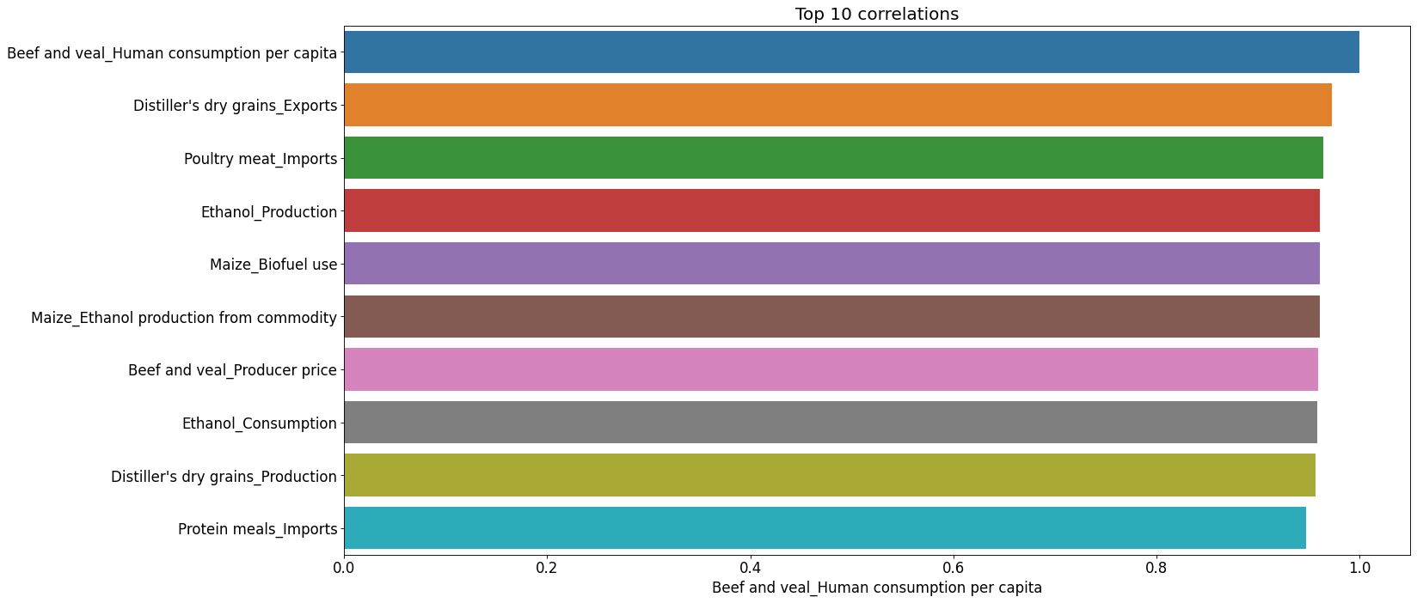
Results: Feature Analysis
P A R T 0 3
Heatmap of Pearson Correlations
Barplot of top 10 most correlated features

Slide 13
Results: Feature Analysis
P A R T 0 3
Model | Evaluation Metric Value | Evaluation Metric Type | Features with Highest Importance Values
Random Forests classifier | 0.563 (0.115) | Accuracy (std.) | fish production sugar ending stocks area harvested for roots and tubers
XGBoost classifier | 0.540 (0.081) | Accuracy (std.) | cheese imports protein meal imports producer price of ethanol
XGBoost regressor | 0.751 (0.112) | MSE (std.) | high fructose corn syrup exports, the area harvested for maize producer price of poultry meat

Slide 14
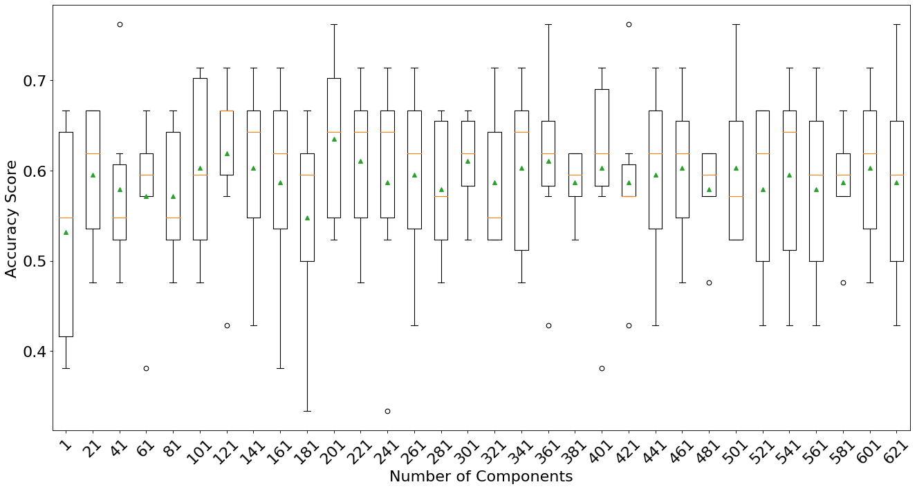
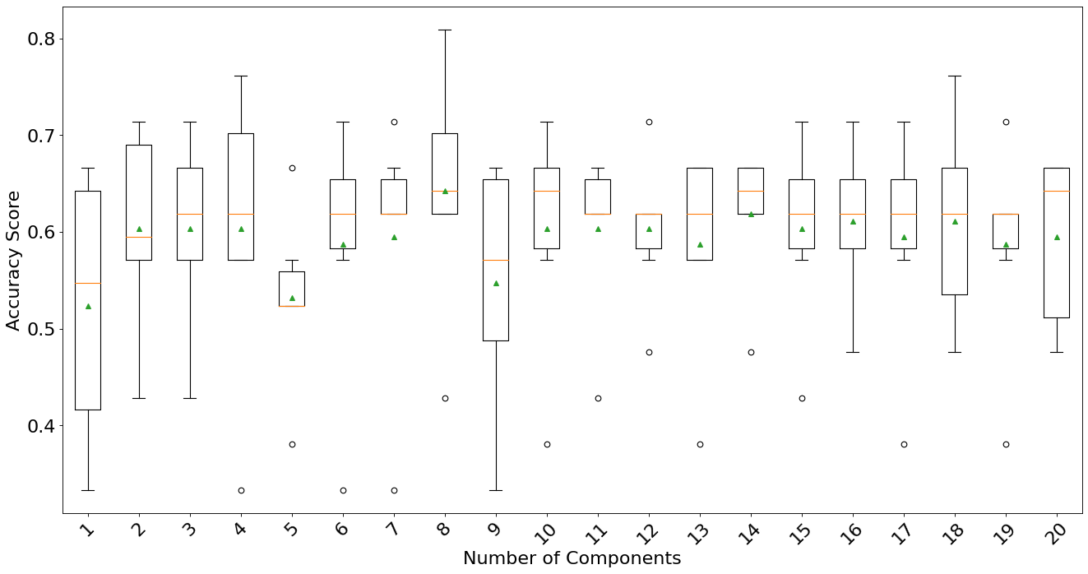
Results: Feature Analysis
P A R T 0 3
Box and whiskers plots of accuracy for Random Forests with SVD embeddings; similar results obtained with UMAP for varying numbers of components. Intervals of 10 on left, intervals of 1 from 1 to 20 on right.

Slide 15
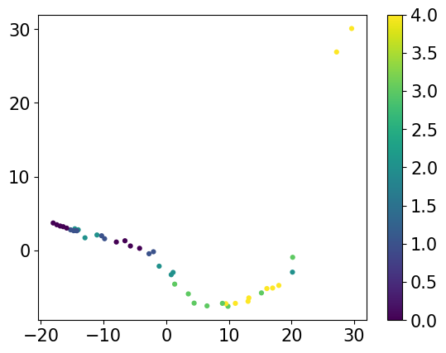
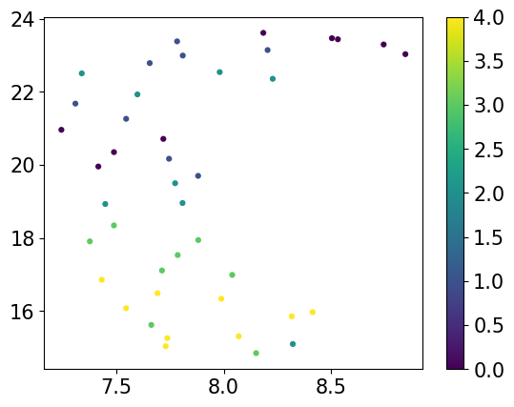
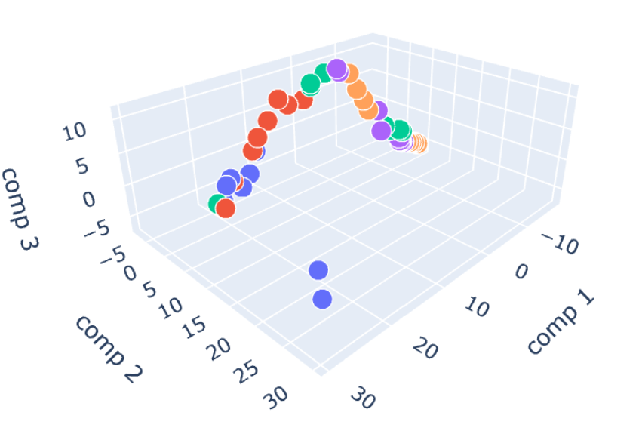
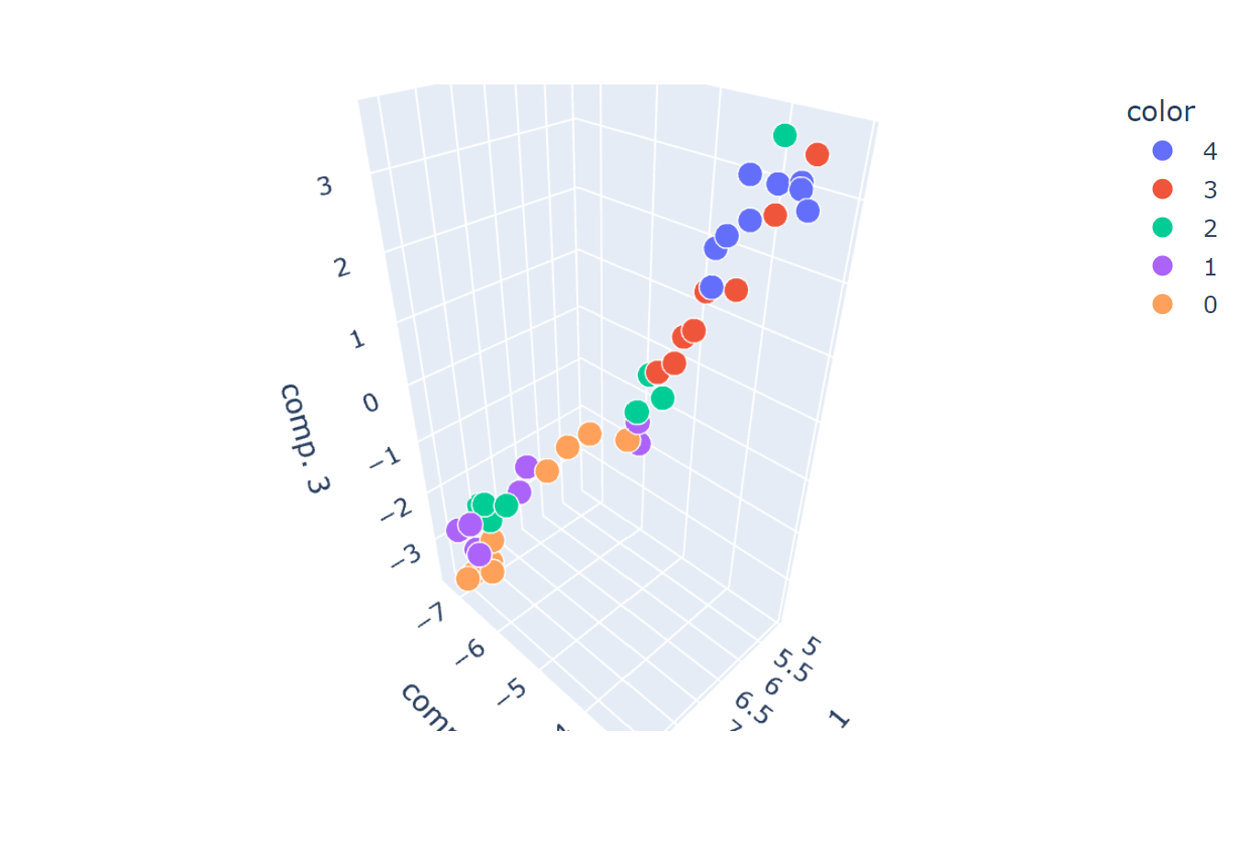
Results: Feature Analysis
P A R T 0 3
2D and 3D SVD and UMAP embeddings color coded by label
SVD Embeddings
UMAP Embeddings

Slide 16
Discussion
P A R T 0 4
Prediction:
The government should consider using KNN regressor model to predict the consumption (by changing numerous commodities values)
This model is specifically designed for the US, so be careful about over-generalizing!
Feature Analysis:
Pearson correlation do not eliminate inter-feature correlations → model instability
Not suitable for real-world applications
With Pearson Correlation, Random Forests and XGBoost variety of commodities highlighted
Each government could subsidize different commodities depending on cultural/religious norms
Dimensionality reduction shows 2/3 features able to represent data well:
Only subsidizing 2/3 features could have significant effects
Data:
More useful features according to prior research done in the subject (GDP per capita etc.)

Slide 17
References
P A R T 0 5
Caleb Robinson, Bistra Dilkina, Jeffrey Hubbs, Wenwen Zhang, Subhrajit Guhathakurta, Marilyn A. Brown, Ram M. Pendyala, Machine learning approaches for estimating commercial building energy consumption, Applied Energy, Volume 208, 2017, Pages 889-904, ISSN 0306-2619, https://doi.org/10.1016/j.apenergy.2017.09.060.
EPA, Environmental Protection Agency: “Inventory of U.S. Greenhouse Gas Emissions and Sinks,” https://www.epa.gov/ghgemissions/inventory-us-greenhouse-gas-emissions-and-sinks.
IPCC, 2019: Summary for Policymakers. In: Climate Change and Land: an IPCC special report on climate change, desertification, land degradation, sustainable land management, food security, and greenhouse gas fluxes in terrestrial ecosystems [P.R. Shukla, J. Skea, E. Calvo Buendia, V. Masson-Delmotte, H.- O. Pörtner, D. C. Roberts, P. Zhai, R. Slade, S. Connors, R. van Diemen, M. Ferrat, E. Haughey, S. Luz, S. Neogi, M. Pathak, J. Petzold, J. Portugal Pereira, P. Vyas, E. Huntley, K. Kissick, M. Belkacemi, J. Malley, (eds.)]. In press.
Neff, Roni A, et al. “Reducing Meat Consumption in the USA: a Nationally Representative Survey of Attitudes and Behaviours.” Public Health Nutrition, vol. 21, no. 10, 2018, pp. 1835–1844., doi:10.1017/S1368980017004190.
OECD, 2023, Meat consumption (indicator). doi: 10.1787/fa290fd0-en (Accessed on 21 March 2023)

Slide 18
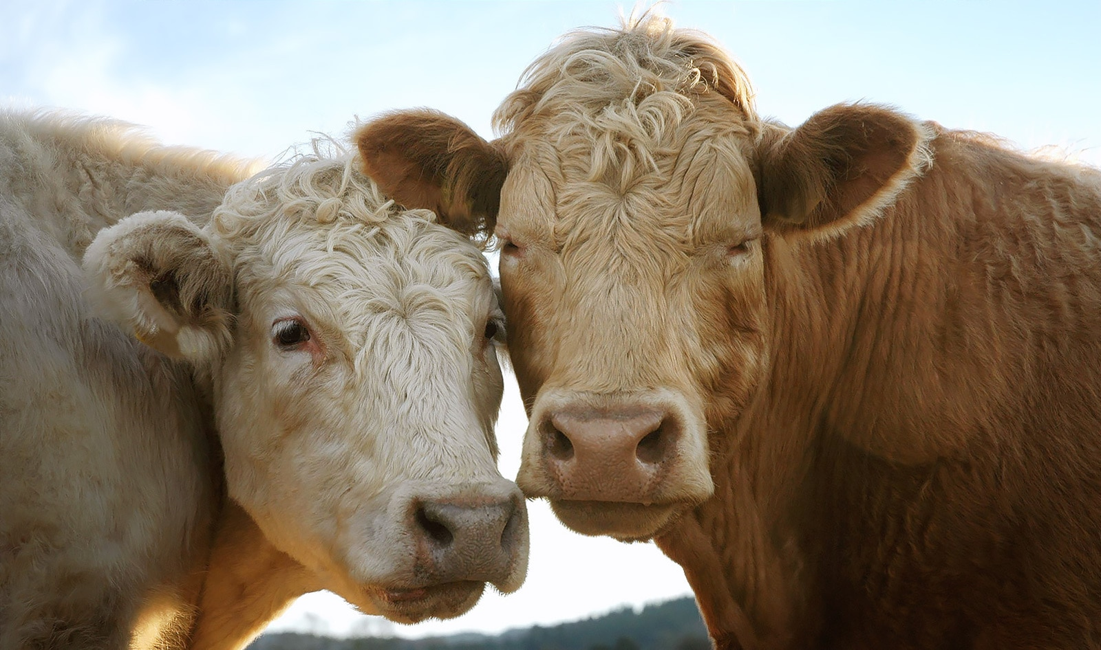
Thank You!

Slide 19
References (images)
P A R T 0 5
https://quantdare.com/what-is-the-difference-between-parameters-and-hyperparameters/
https://www.linkedin.com/posts/giorgiotorre1234_machinelearning-deeplearning-machinelearning-activity-6979036271570530305-KUah/
https://www.eatingwell.com/article/7994363/what-happens-to-your-body-when-you-eat-red-meat-every-day/
https://www.dtn.com/what-is-an-agricultural-commodity/
https://blog.finxter.com/tutorial-how-to-create-your-first-neural-network-in-1-line-of-python-code/
linkedin.com/pulse/export-from-europe-agriculture-commodities-elena-vishnevskaya/
https://viterbi-web.usc.edu/~krupske/itp301/lab_04/cow-gallery.html
https://5minutecrafts.site/learn-tricks/the-difference-between-veal-and-beef-2038/
https://datamites.com/blog/what-is-cross-validation-and-validation-in-machine-learning/
https://stackoverflow.com/questions/37161563/how-to-graph-grid-scores-from-gridsearchcv

Slide 20
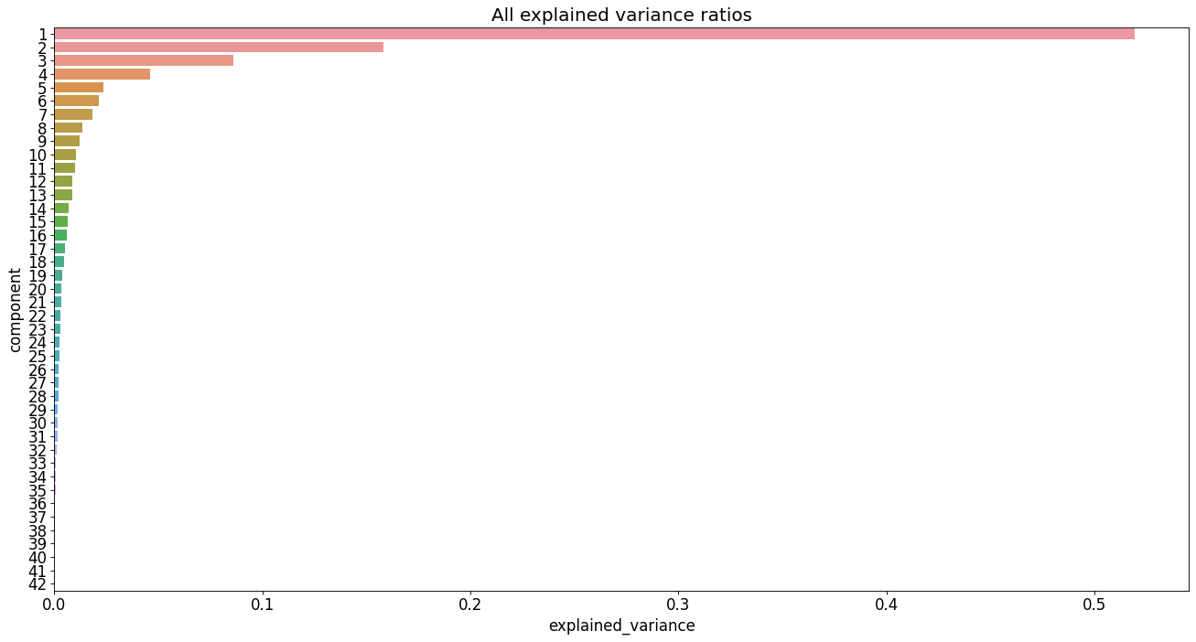
Results: Feature Analysis
P A R T 0 3
Bar plot of explained variance ratios for Random Forests with SVD embeddings;
similar results obtained with UMAP

Slide 21


Slide 22


Slide 23
